Slide 1


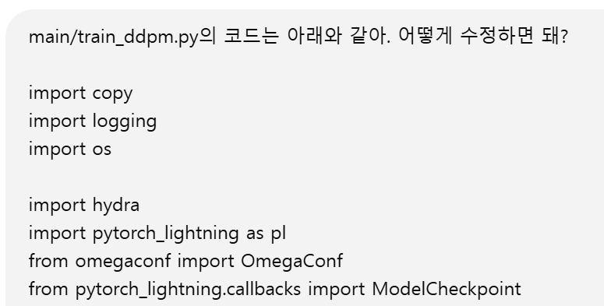

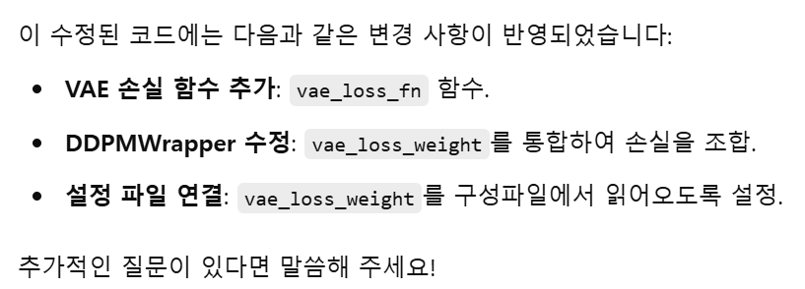
import copy
import logging
import os
import hydra
import pytorch_lightning as pl
from omegaconf import OmegaConf
from pytorch_lightning.callbacks import ModelCheckpoint
from pytorch_lightning.utilities.seed import seed_everything
from torch.utils.data import DataLoader
from models.callbacks import EMAWeightUpdate
from models.diffusion import DDPM, DDPMv2, DDPMWrapper, SuperResModel, UNetModel
from models.vae import VAE
from util import configure_device, get_dataset
import torch
import torch.nn.functional as F
logger = logging.getLogger(__name__)
def __parse_str(s):
split = s.split(",")
return [int(s) for s in split if s != "" and s is not None]
# Define VAE loss function
def vae_loss_fn(x, vae):
z, x_recon, mu, logvar = vae(x)
recon_loss = F.mse_loss(x_recon, x, reduction="mean")
kl_div = -0.5 * torch.sum(1 + logvar - mu.pow(2) - logvar.exp()) / x.size(0)
return recon_loss + kl_div
@hydra.main(config_path="configs/dataset/cifar10", config_name="train")
def train(config):
# Get config and setup
config = config.ddpm
logger.info(OmegaConf.to_yaml(config))
# Set seed
seed_everything(config.training.seed, workers=True)
# Dataset
root = config.data.root
d_type = config.data.name
image_size = config.data.image_size
dataset = get_dataset(
d_type, root, image_size, norm=config.data.norm, flip=config.data.hflip
)
N = len(dataset)
batch_size = config.training.batch_size
batch_size = min(N, batch_size)
# Model
lr = config.training.lr
attn_resolutions = __parse_str(config.model.attn_resolutions)
dim_mults = __parse_str(config.model.dim_mults)
ddpm_type = config.training.type
decoder_cls = UNetModel if ddpm_type == "uncond" else SuperResModel
decoder = decoder_cls(
in_channels=config.data.n_channels,
model_channels=config.model.dim,
out_channels=3,
num_res_blocks=config.model.n_residual,
attention_resolutions=attn_resolutions,
channel_mult=dim_mults,
use_checkpoint=False,
dropout=config.model.dropout,
num_heads=config.model.n_heads,
z_dim=config.training.z_dim,
use_scale_shift_norm=config.training.z_cond,
use_z=config.training.z_cond,
)
ema_decoder = copy.deepcopy(decoder)
for p in ema_decoder.parameters():
p.requires_grad = False
ddpm_cls = DDPMv2 if ddpm_type == "form2" else DDPM
online_ddpm = ddpm_cls(
decoder,
beta_1=config.model.beta1,
beta_2=config.model.beta2,
T=config.model.n_timesteps,
)
target_ddpm = ddpm_cls(
ema_decoder,
beta_1=config.model.beta1,
beta_2=config.model.beta2,
T=config.model.n_timesteps,
)
vae = VAE.load_from_checkpoint(
config.training.vae_chkpt_path,
input_res=image_size,
)
vae.eval()
for p in vae.parameters():
p.requires_grad = False
logger.info(f"Using DDPM with type: {ddpm_cls} and data norm: {config.data.norm}")
# Modified DDPMWrapper
ddpm_wrapper = DDPMWrapper(
online_ddpm,
target_ddpm,
vae,
lr=lr,
cfd_rate=config.training.cfd_rate,
n_anneal_steps=config.training.n_anneal_steps,
loss=config.training.loss,
conditional=False if ddpm_type == "uncond" else True,
grad_clip_val=config.training.grad_clip,
z_cond=config.training.z_cond,
vae_loss_weight=config.training.vae_loss_weight # Added VAE loss weight
)
# Trainer
train_kwargs = {}
restore_path = config.training.restore_path
if restore_path != "":
train_kwargs["resume_from_checkpoint"] = restore_path
results_dir = config.training.results_dir
chkpt_callback = ModelCheckpoint(
dirpath=os.path.join(results_dir, "checkpoints"),
filename=f"ddpmv2-{config.training.chkpt_prefix}" + "-{epoch:02d}-{loss:.4f}",
every_n_epochs=config.training.chkpt_interval,
save_on_train_epoch_end=True,
)
train_kwargs["default_root_dir"] = results_dir
train_kwargs["max_epochs"] = config.training.epochs
train_kwargs["log_every_n_steps"] = config.training.log_step
train_kwargs["callbacks"] = [chkpt_callback]
if config.training.use_ema:
ema_callback = EMAWeightUpdate(tau=config.training.ema_decay)
train_kwargs["callbacks"].append(ema_callback)
device = config.training.device
loader_kws = {}
if device.startswith("cpu"):
_, devs = configure_device(device)
train_kwargs["cpu"] = devs
from pytorch_lightning.plugins import DDPPlugin
train_kwargs["plugins"] = DDPPlugin(find_unused_parameters=False)
loader_kws["persistent_workers"] = True
elif device == "tpu":
train_kwargs["tpu_cores"] = 8
if config.training.fp16:
train_kwargs["precision"] = 16
loader = DataLoader(
dataset,
batch_size,
num_workers=config.training.workers,
pin_memory=True,
shuffle=True,
drop_last=True,
**loader_kws,
)
logger.info(f"Running Trainer with kwargs: {train_kwargs}")
trainer = pl.Trainer(**train_kwargs)
trainer.fit(ddpm_wrapper, train_dataloader=loader)
if __name__ == "__main__":
train()

